Slide 1
The Beagle Voyage
Cross curricular:
History, English, Science, D+T
Ages: 11-14
Key stage 3
Notes:
This presentation will introduce key moments in Darwin’s life and provide a context for the accompanying activities.

Slide 2
Who was Charles Darwin?
Notes:
What do we know about Darwin? What is he famous for?
Darwin was born in Shrewsbury in 1809. He had a lifelong fascination for nature, observation and discovery.
He went on to become the most influential scientist, writer and thinker on evolution.

Slide 3
Darwin as a young man
Notes:
In 1825, when Darwin was 16, he went to Edinburgh University to study medicine but did not enjoy his studies and left after two years. He then enrolled for a classical degree at Cambridge University and was a student at Christ’s College. He had an idea to become a clergyman with a country parish. This appealed to Darwin as it would allow him to continue exploring the natural world; a common pursuit for a clergyman at that time.

Slide 4
The offer to join the voyage of a lifetime
Notes:
In August 1831 when Darwin was 22, his botany professor, John Stevens Henslow, wrote to him unexpectedly. Henslow offered Darwin the opportunity to join young Captain FitzRoy aboard HMS Beagle on a voyage around the world to create sea-charts. The ship was to sail round the coast of South America and home via Australia and Mauritius. The offer had been made to two others before Darwin, but they had had to turn it down for family reasons

Slide 5
Captain FitzRoy and HMS Beagle
Notes:
Henslow told Darwin that Captain FitzRoy was looking for a scientific minded gentleman who would also be a companion for the captain. The voyage would be would be an excellent opportunity to collect, observe, and write about flora, fauna, and geology in South America and beyond. The voyage was to last for two years initially.
Henslow wrote to Darwin that ‘there was never a finer chance for a man of zeal and spirit’

Slide 6
Darwin’s father’s reaction to the offer
Notes:
Darwin’s father, Robert Waring Darwin, had many objections to his son joining the voyage; he thought it was a ‘wild scheme’ and potentially not safe as others had already turned it down. His father thought it would jeopardise his career and that he wouldn’t settle afterwards. A list was produced of his concerns.
Josiah Wedgwood II, Darwin’s uncle, wrote to Robert Waring Darwin and addressed each of his concerns, trying to convince his brother that this would be a great opportunity for Charles.
After reading the letter Darwin’s father consented and gave permission for his son to join the voyage. Darwin later referred to the voyage as ‘by far the most important event in my life’.

Slide 7
Plan of HMS Beagle
Notes:
Darwin joined the second voyage of HMS Beagle. Although this voyage had been commissioned by the admiralty, Captain FitzRoy had insisted on many alterations to the ship, often paying for them himself. He added a third mast to make it more stable at sea, raised the deck to make it more comfortable and created space for the many surveying instruments he had on board.
Darwin’s cabin (which he shared with others) was below the Poop deck at the rear or stern of the ship. He had the benefit of the skylight but it was a cramped space for hammocks, books and research equipment.

Slide 8
Where did HMS Beagle go?
Notes:
HMS Beagle set sail from Plymouth in December 1831. During the voyage much time was spent exploring the coastline of South America. Darwin was often free to carry out his own expeditions and spent a total of three years on land, exploring, observing and collecting. This was a great relief as well as an opportunity for research, as he was seasick for much of the voyage! Darwin wrote regularly to his friends and family about his research, the new lands and people he encountered, and the wonder of the natural world. The ship returned home via the Galápagos Islands, New Zealand, Australia and South Africa. Darwin arrived back in Plymouth in October 1836, almost five years after setting off.

Slide 9
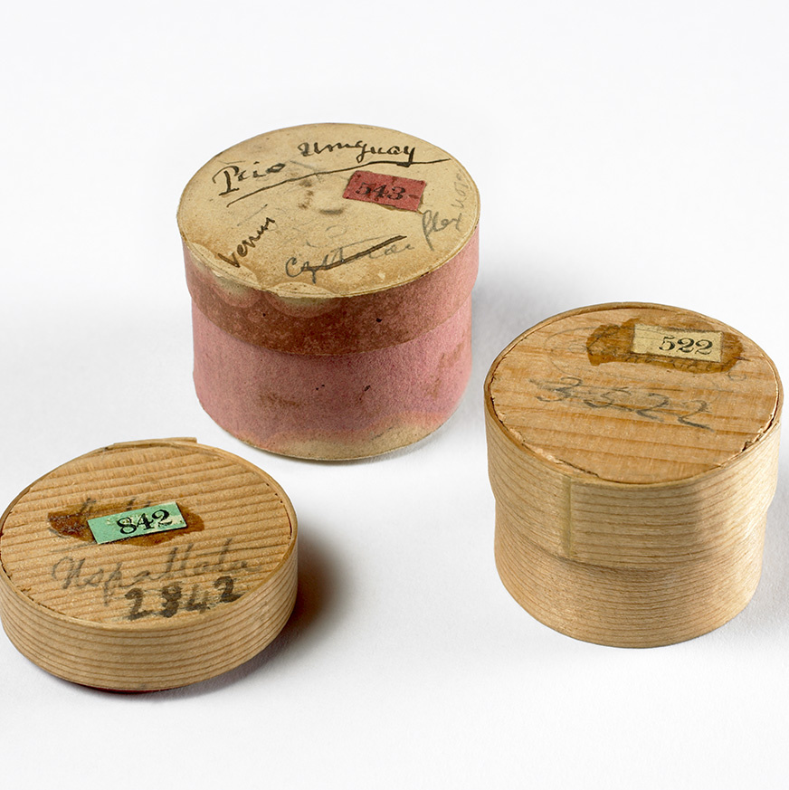
Specimens big and small
Notes:
During the voyage Darwin collected and sent back many thousands of samples and specimens including rocks, fossils, insects, animals, and plants. The bones belong to a Megatherium (giant ground sloth) that lived in South America around 5.3 million years ago.
Darwin’s collections were sometimes packaged in whatever containers he had to hand, including these pill boxes which were used to protect small geology samples. The trunks full of specimens were sent home regularly via ships that were returning to England. The collections were received first in Cambridge by Professor Henslow, then distributed to other scientific experts who could help to uncover more about the objects that Darwin had sent home.

Slide 10
Adventures with animals
Notes:
Darwin was advised about conserving and packing animal specimens to avoid them rotting on the long journey home. He had to ensure that there were no insects already living on or inside the animals. Fish were preserved in vats of alcohol. Giant tortoises on the Galápagos Islands helped Darwin to study adaptations but also provided food for sailors. At the time it was common for them to be taken on board alive as they could survive long periods without water and could be killed and eaten when needed. Darwin wrote in his diary in 1835 ’Young Tortoises make capital soup — otherwise the meat is but, to my taste, indifferent food.’

Slide 11
Life after the voyage
Notes:
In 1836, Darwin returned to England with a career’s worth of scientific observations. With his vast collection of new specimens and
observations, Darwin became an important member of the British scientific community. Darwin wrote four books based on the voyage,
including his popular Journal of researches (later known as Voyage of the beagle). He spent twenty further years developing and testing his
ideas before publishing on evolution and natural selection.
In 1842, he married Emma Wedgwood and soon moved to Down House in Kent. They raised a family (ten children, of whom seven survived
to adulthood). Darwin worked and carried out most of his research at home, often enlisting the help of his family. He wrote and received over
15,000 letters in his lifetime, corresponding with amateur and professional naturalists from Britain and around the world. Darwin used his
correspondence to gather information and specimens to help develop his theories. He also still had easy access to the heart of the
British scientific community in London, around 20 miles away.

Slide 12
Adventures with plants
Sicyos villosa, a vine Darwin collected in the Galápagos Islands
Notes:
Darwin collected many plant specimens on expeditions. They were pressed and dried before packing them in to trunks to send home. He made sure to gather as many parts of the plant that he could find; leaves, stem, flowers, fruit and seeds.
When the specimens reached England they were each arranged onto herbarium sheets that recorded as much information as possible. This plant was collected in the Galápagos Islands. It became extinct within ten years of Darwin seeing it and is the only known example.

Slide 13
Evolution and beyond
Notes:
Darwin wrote 15 books and 130 scientific papers while living at Down, including On the Origin of Species in 1859, which stands as the
foundation of evolutionary biology. Although this is his most famous work, he continued to publish until 1881, months before he died. His
final book was partly informed by research done in his back garden, it was called The Formation of Vegetable Mould through the Action of
Worms, with Observations on their Habits. This book sold more copies in his lifetime than the controversial On the Origin of Species.

Slide 14
Acknowledgements
Images
Slide 2: Artwork based on sketch of Darwin by George Richmond held at Cambridge University Library, DAR 225:119, DAR 14.6
Slide 3: Cambridge University Library
Slide 4: US National Library of Medicine IMH (B014334), CUL (DAR 97: B4)
Slide 5: Robert FitzRoy (NPG x 128426) © National Portrait Gallery , London (CC by-NC-ND 3.0),
HMS Beagle, courtesy of Simon Keynes
Slide 6: Dr Robert Waring Darwin, oil by W.W Oulessl. (SHYMS:FA/1991/033/2) ©Shrewsbury Museums service, CUL (DAR 97: B10)
Slide 7: Beagle blueprint, Cambridge University Library
Slide 8: CUL, map data by Free Vector Maps
Slide 9: Images from collections at Cambridge University Museum of Zoology/ Sedgwick Museum, artist impression of Megatherium, CUL
Slide 10: Steamer duck and fish from the collections at Cambridge University Museum of Zoology, giant tortoise: Vanessa Green, Galapagos Conservation Trust
Slide11: CUL (DAR 225:29a, CUL, artwork based on DAR 233.1:17, DAR 233.2:18)
Slide 12: Sicyos villosa from the collections at Cambridge University Herbarium
Slide 13: CUL (DAR 225:119, Keynes.M2.27)

