Slide 1
Darwin’s scientific experiments
Topic: Science
Ages: 11-14
Key stage 3
Notes:
This presentation will introduce key moments in Darwin’s life and provide a context for the accompanying activities.

Slide 2
Who was Charles Darwin?
Notes:
What do we know about Darwin? What is he famous for?
Darwin was born in Shrewsbury in 1809. He had a lifelong fascination for nature, observation and discovery.
He went on to become the most influential scientist, writer and thinker on evolution.

Slide 3
Darwin as a young man
Notes:
In 1825, when Darwin was 16, he went to Edinburgh University to study medicine but did not enjoy his studies and left after two years. He then enrolled for a classical degree at Cambridge University and was a student at Christ’s College. He had an idea to become a clergyman with a country parish. This appealed to Darwin as it would allow him to continue exploring the natural world, a common pursuit for a clergyman at that time.

Slide 4
Darwin receives an offer
Notes:
In August 1831 when Darwin was 22, his botany professor, John Stevens Henslow, wrote to him unexpectedly. Henslow offered Darwin the opportunity to join young Captain FitzRoy aboard HMS Beagle on a voyage around the world to create sea-charts. The ship was to sail round the coast of South America and home via Australia and Mauritius. The offer had been made to two others before Darwin, but they had had to turn it down for family reasons. After satisfying his father’s initial reservations, Darwin was able to accept the opportunity to join the voyage.

Slide 5
Where did HMS Beagle go?
Notes:
HMS Beagle set sail from Plymouth in December 1831. Much of the voyage was spent exploring the coastline of South America. Darwin was often free to carry out his own expeditions and spent a total of three years on land, exploring, observing and collecting. Darwin wrote regularly to his friends and family about his research, the new lands and people he encountered, and the wonder of the natural world.
The ship returned home via the Galápagos Islands, New Zealand, Australia and South Africa. Darwin arrived back in Plymouth in October 1836, almost five years after setting off.

Slide 6
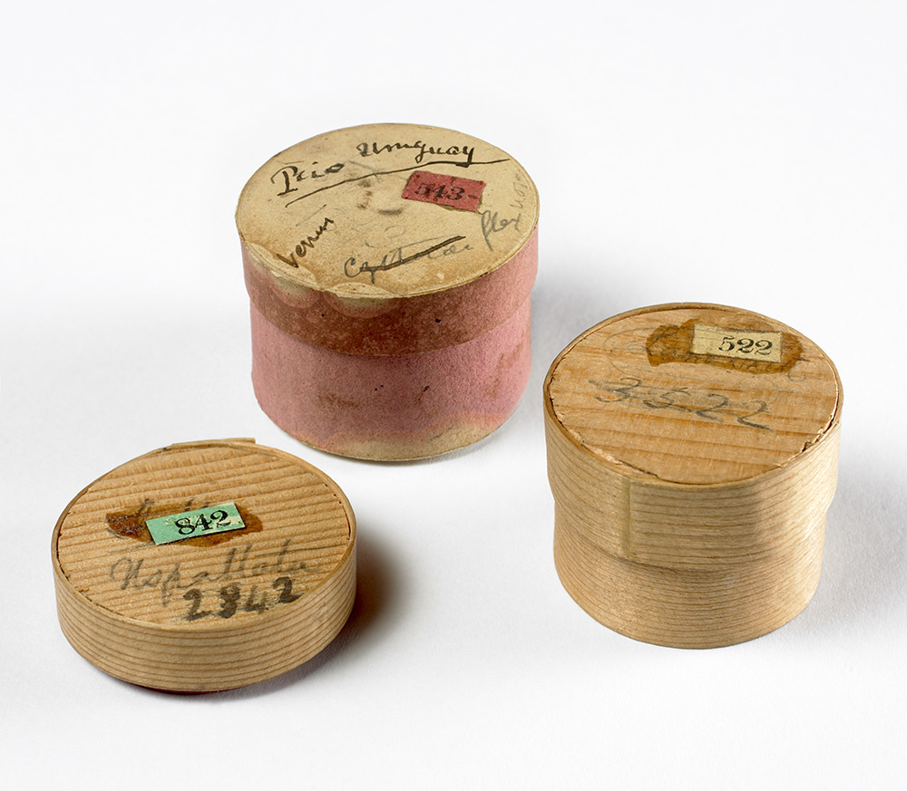
Specimens big and small
Notes:
During the voyage Darwin collected and sent back many thousands of samples and specimens including rocks, fossils, insects, animals, and plants. The bones belong to a Megatherium (giant ground sloth) that lived in South America around 5.3 million years ago.
Darwin’s collections were sometimes packaged in whatever containers he had to hand, including these pill boxes which were used to protect small geology samples. The trunks full of specimens were sent home regularly via ships that were returning to England. The collections were received first in Cambridge by Professor Henslow, then distributed to other scientific experts who could help to uncover more about the objects that Darwin had sent home.

Slide 7
Change over time
Notes:
The remarkable specimens that he collected during the voyage gave Darwin food for thought. Whilst at Cambridge had been particularly interested in geology, the study of how rocks form and change over time. He had also studied variety and adaptation in plants with Professor Henslow and was fascinated by the question of where life came from and what caused life-forms to change. The observations and discoveries he made on the Beagle voyage inspired Darwin’s research for many years to come.

Slide 8
Life after the voyage
Notes:
In 1836 Darwin returned to England with a career’s worth of scientific observations. With his vast collection of new specimens and
observations, Darwin became an important member of the British scientific community. Darwin wrote four books based on the voyage,
including his popular Journal of researches. He spent twenty further years developing and testing his ideas before publishing on evolution
and natural selection.
In 1839 he married Emma Wedgwood, his first cousin. They moved to Down House in Kent in 1842, where they raised a family (ten children,
seven of whom survived to adulthood). His home became his workplace and he often enlisted the help of his family. From Down, he
still had easy access to the heart of the British scientific community in London, around twenty miles away.

Slide 9
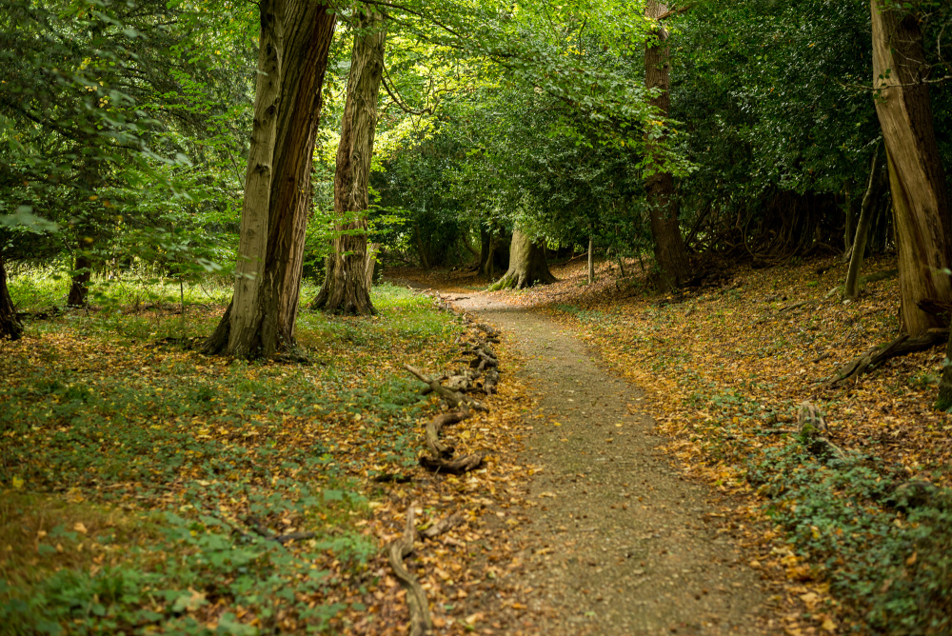
Life at Down House
Notes:
For forty years Darwin conducted scientific observations and experiments in and around his home – in the flower garden, kitchen garden,
hothouse, orchard, meadow, and nearby woodland. Darwin walked and rode through the rural countryside around Down House observing
the natural world. The countryside became his open-air laboratory and every walk became fieldwork. He wrote and received over 15,000
letters in his lifetime, corresponding with amateur and professional naturalists from Britain and around the world. Darwin used his
correspondence to gather information and specimens to help him construct his theories.

Slide 10
Observations from home
Notes:
Darwin’s observations included studying the flight paths of bumble bees. He positioned his children at specific places in a field and they shouted ‘Here’s a bee’ on spotting one. He was puzzled, but suspected that bees inherited the instinct to follow certain routes. He wrote to colleague Hermann Muller: ‘The routes remain the same for a considerable time and the buzzing places are exactly the same to within an inch.’ He observed behaviour in the male bees that seemed to be passed by inherited instinct (not learned) in successive generations.
Darwin also developed a weed garden in which to monitor the natural germination and survival of plants in a small patch of land over a fixed period of time. The local countryside inspired Darwin to ask questions about what he saw, where things came from, and under what conditions they were able to survive.

Slide 11
Evolution and beyond
Notes:
Darwin wrote 15 books and 130 scientific papers while living at Down, including On the Origin of Species in 1859, which stands as the
foundation of evolutionary biology. Although this is his most famous work, he continued to publish until 1881, months before he died. His
final book was partly informed by research done in his back garden, it was called The Formation of Vegetable Mould through the Action of
Worms, with Observations on their Habits. This book sold more copies in his lifetime than the controversial On the Origin of Species. Darwin
proved that ground-breaking science can begin by observing and analysing what is around you, and through continually asking
questions about the natural world.

Slide 12
Acknowledgements
Images
Slide 2: Artwork based on sketch of Darwin by George Richmond held at Cambridge University Library, DAR 225:119, DAR 14.6
Slide 3: Cambridge University Library
Slide 4: US National Library of Medicine IMH (B014334), CUL (DAR 97: B4)
Slide 5: CUL, map data by Free Vector Maps
Slide 6: Images from collections at Cambridge University Museum of Zoology/
Sedgwick Museum, artist impression of Megatherium, CUL
Slide 7: CUL DAR 44.13, giant tortoise : Vanessa Green, Galapagos Conservation Trust
Slide 8: CUL, artwork based on DAR 233.1:17, Keynes.M.2.27, DAR 233.2.18
Slide 9: Down House hothouse, Century Illustrated Monthly Magazine, January 1833,
Down House, woodland, DCP with permission from Down House
Slide 10: Hollyhock and bee DCP own, weed garden DCP with permission from Down House
Slide 11: Cambridge University Library (DAR 225:119, Keynes.M2.27)

