Slide 1
Darwin’s offer of a lifetime
Topic: English
Ages: 11-14
Key stage 3
Notes:
This presentation will introduce key moments in Darwin’s life and provide a context for the accompanying activities.

Slide 2
Who was Charles Darwin?
Notes:
What do we know about Darwin? What is he famous for?
Darwin was born in Shrewsbury in 1809. He had a lifelong fascination for nature, observation and discovery.
He went on to become the most influential scientist, writer and thinker on evolution.

Slide 3
Darwin as a young man
Notes:
In 1825, when Darwin was 16, he went to Edinburgh University to study medicine but did not enjoy his studies and left after two years. He then enrolled for a classical degree at Cambridge University and was a student at Christ’s College. He had an idea to become a clergyman with a country parish. This appealed to Darwin as it would allow him to continue exploring the natural world; a common pursuit for a clergyman at that time.

Slide 4
The offer to join a voyage of a lifetime
Notes:
In August 1831, when Darwin was 22, his botany professor, John Stevens Henslow, wrote to him unexpectedly. Henslow offered Darwin the opportunity to join the young Captain FitzRoy aboard HMS Beagle on a voyage around the world to create sea-charts. The ship was to sail round the coast of South America and home via Australia and Mauritius. The offer had been made to two others before Darwin, but they had had to turn it down for family reasons.

Slide 5
Captain FitzRoy and HMS Beagle
Notes:
Henslow told Darwin that Captain FitzRoy was looking for a scientific minded gentleman who would also be a companion for the captain. The voyage would be would be an excellent opportunity to collect, observe, and write about flora, fauna, and geology in South America and beyond. The voyage was to last for two years initially.
Henslow said ‘there was never a finer chance for a man of zeal and spirit’

Slide 6
Darwin’s father’s reaction to the offer
Notes:
Darwin’s father, Robert Waring Darwin, had many objections to his son joining the voyage; he thought it was a ‘wild scheme’ and potentially not safe, as others had already turned it down. His father thought it would jeopardise his career and that he wouldn’t settle afterwards. A list was produced of his concerns. Josiah Wedgwood II, Darwin’s uncle, wrote to Robert Waring Darwin and addressed each of his concerns, trying to convince his brother that this would be a great opportunity for Charles. After reading the letter Darwin’s father consented and gave permission for his son to join the voyage.

Slide 7
Where did the ship go?
Notes:
HMS Beagle set sail from Plymouth in December 1831. During the voyage much time was spent exploring the coastline of South America. Darwin was often free to carry out his own expeditions and spent a total of three years on land, exploring, observing and collecting. Darwin wrote regularly to his friends and family about his research, the new lands and people he encountered, and the wonder of the natural world. The ship returned home via the Galápagos Islands, New Zealand, Australia and South Africa. Darwin arrived back in Plymouth in October 1836, almost five years after setting off.

Slide 8
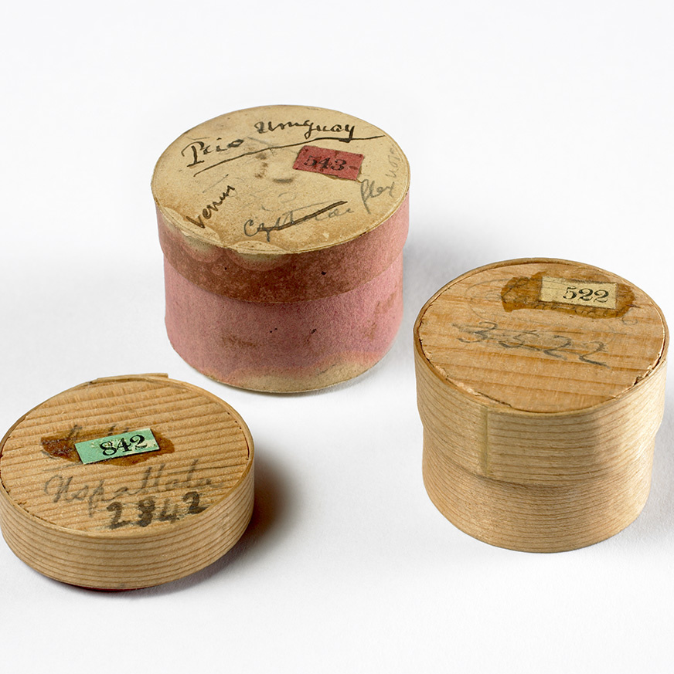
Specimens big and small
Notes:
During the voyage Darwin collected and sent back many thousands of samples and specimens including rocks, fossils, insects, animals, and plants. The bones belong to a Megatherium (giant ground sloth) that lived in South America around 5.3 million years ago.
Darwin’s collections were sometimes packaged in whatever containers he had to hand, including these pill boxes which were used to protect small geology samples. The trunks full of specimens were sent home regularly via ships that were returning to England. The collections were received first in Cambridge by Professor Henslow, then distributed to other scientific experts who could help to uncover more about the objects that Darwin had sent home.

Slide 9
Life after the voyage
Notes:
In 1836, Darwin returned to England with a career’s worth of scientific observations. With his vast collection of new specimens and
observations, Darwin became an important member of the British scientific community. Darwin wrote four books based on the voyage,
including his popular Journal of Researches (later known as Voyage of the Beagle).
In 1842, he married Emma Wedgwood and they soon moved to Down House in Kent. They raised a family (ten children, of whom seven
survived to adulthood). Darwin worked and carried out most of his research at home, often enlisting the help of his family. Down House
became Darwin’s science lab as well as his home.

Slide 10
Evolution and beyond
Notes:
Darwin wrote and received over 15,000 letters in his lifetime, corresponding with 2000 amateur and professional naturalists from Britain and
around the world. He used his correspondence to gather information and specimens to help develop his theories.
Darwin wrote fifteen books and 130 scientific papers while living at Down, including On the Origin of Species in 1859, which stands as the
foundation of evolutionary biology. The vast collections and observations he had made during the Beagle voyage informed his investigations
and further research for the rest of his career.
Through these, he greatly increased scientific knowledge and discovery. The chance to join the voyage had proved the offer of a lifetime.
Darwin referred to the voyage as ‘by far the most important event in my life’.

Slide 11
Acknowledgements
Images
Slide 2: Artwork based on sketch of Darwin by George Richmond held at Cambridge University Library, DAR 225:119, DAR 14.6
Slide 3: Cambridge University Library
Slide 4: US National Library of Medicine IMH (B014334), CUL (DAR 97: B4)
Slide 5: Robert FitzRoy (NPG x 128426), © National Portrait Gallery, London
(CC by-NC-ND 3.0), HMS Beagle, courtesy of Simon Keynes
Slide 6: Dr Robert Waring Darwin, oil by W.W Oulessl. (SHYMS:FA/1991/033/2) ©Shrewsbury Museums service, CUL (DAR 97: B10)
Slide 7: CUL), Map data by Free Vector Maps
Slide 8: Images from collections at Cambridge University Museum of Zoology/ Sedgwick Museum, artist impression of Megatherium, CUL
Slide 9: CUL, artwork based on DAR 233.1:17, Keynes.M.2.27, DAR 233.2.18
Slide 10: CUL (DAR-225:119, Keynes.M2.27)

